Slide 1
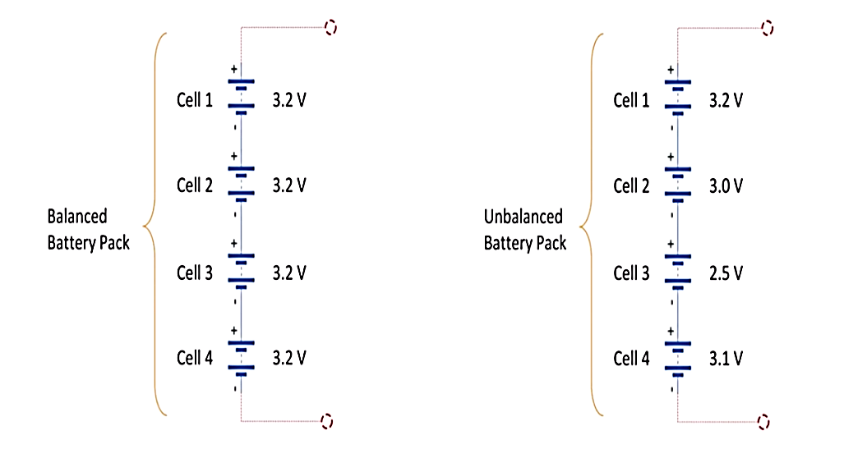
Capacity Management

Slide 2
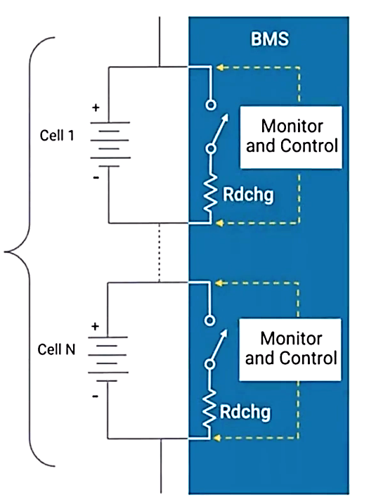
Capacity Management
Battery Stack

Slide 3
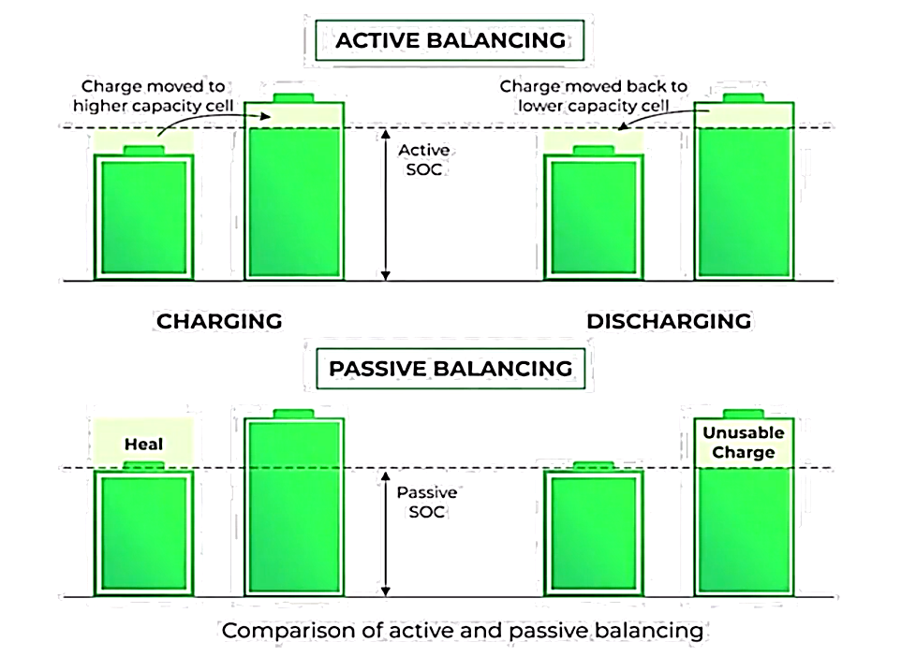
Capacity Management

